Slide 1





→
Supercomputer:
Always Faster?
LET’S CODE!
(version 1.0)
Licensed under CC BY-NC-SA
Pierre Talbot (pierre.talbot@uni.lu)
Angelica Rings

Slide 2
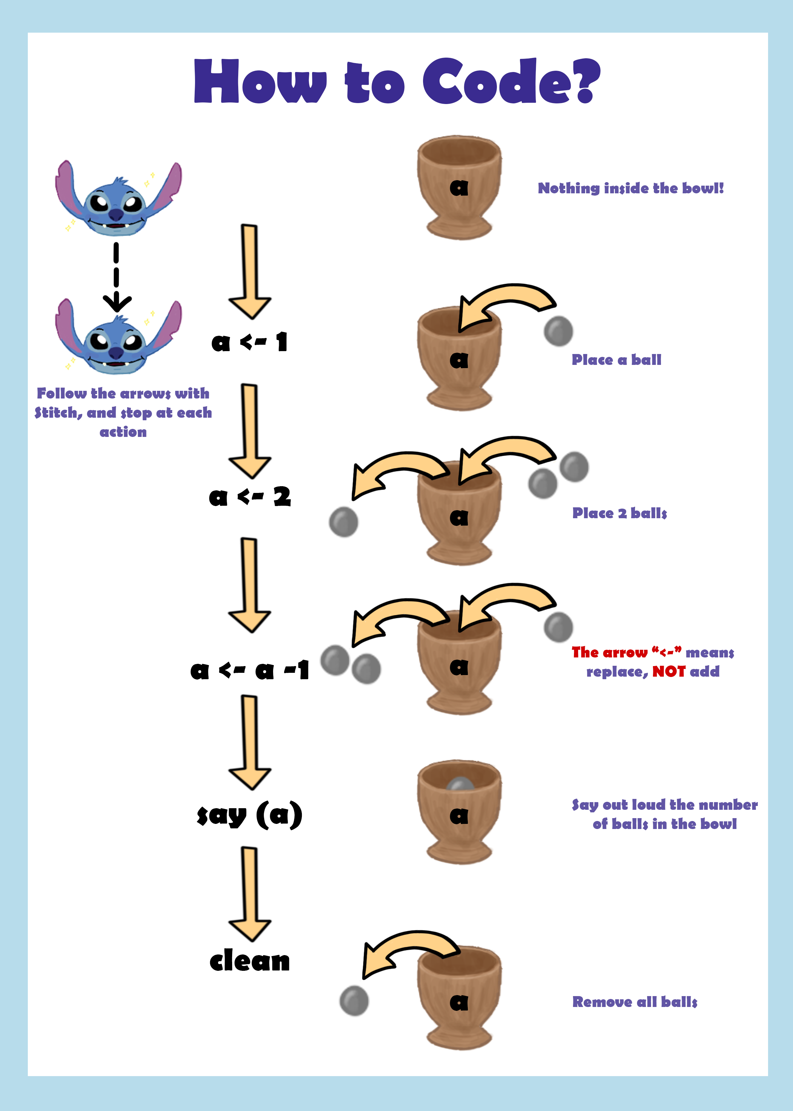

Slide 3


Slide 5
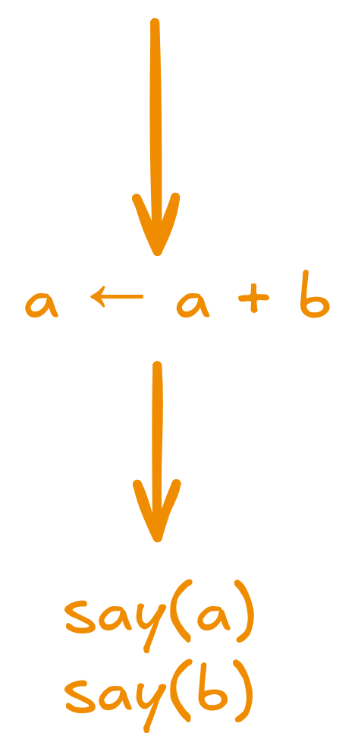

Slide 6
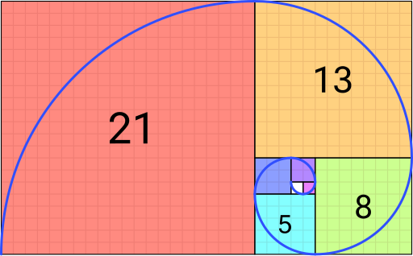
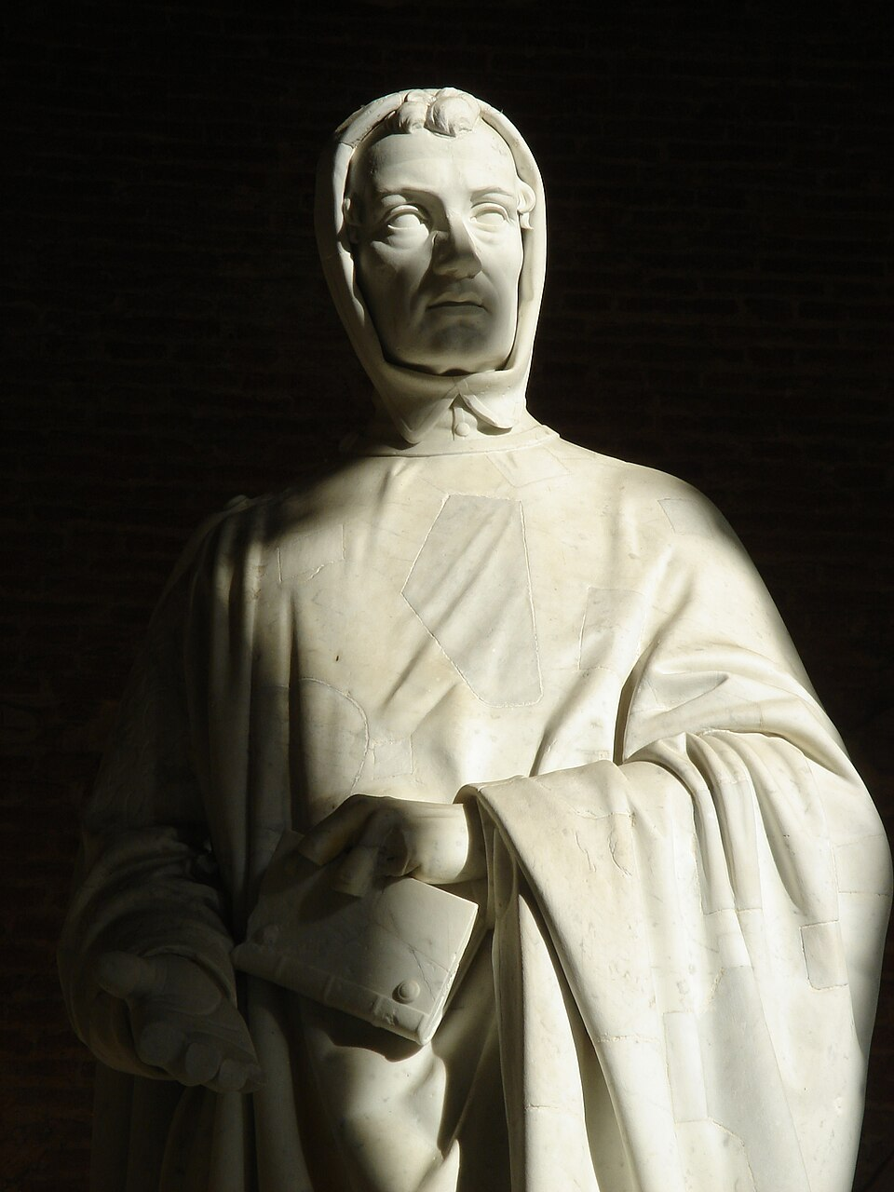
One famous problem
Fibonacci sequence
The Fibonacci sequence is a sequence in which each element is the sum of the two elements that precede it.
Can you compute the first 5 elements of the sequence?
Leonardo Bonacci (c. 1170 – c. 1240-50), aka. Fibonacci, was an Italian mathematician, considered to be "the most talented Western mathematician of the Middle Age".
Note that this sequence was already discovered in India by Pingala (200 BC.)
Credits: images and text from Wikipedia

Slide 7
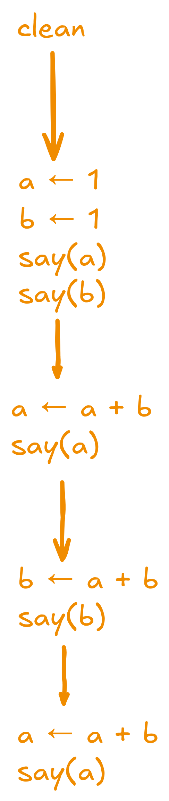

Slide 8
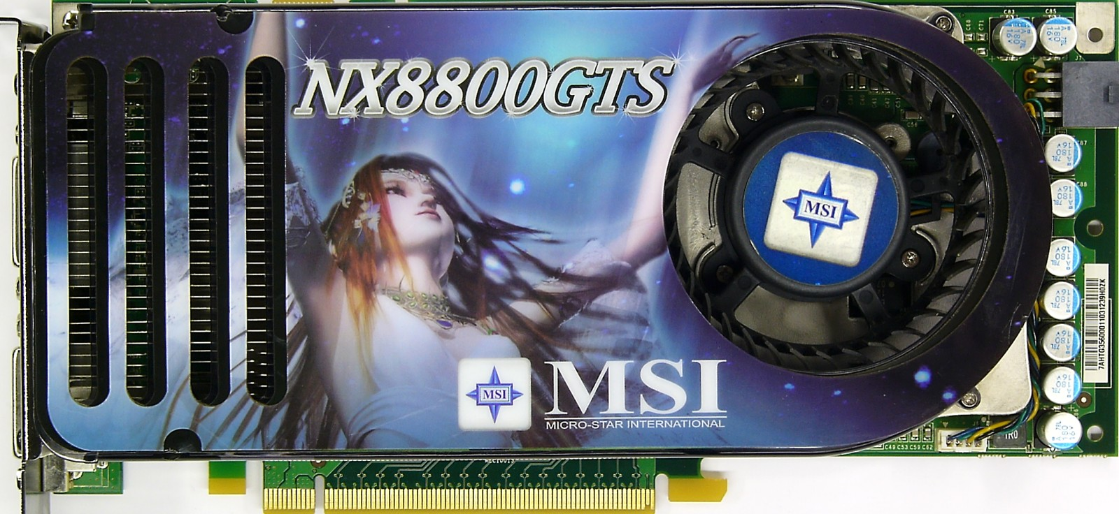
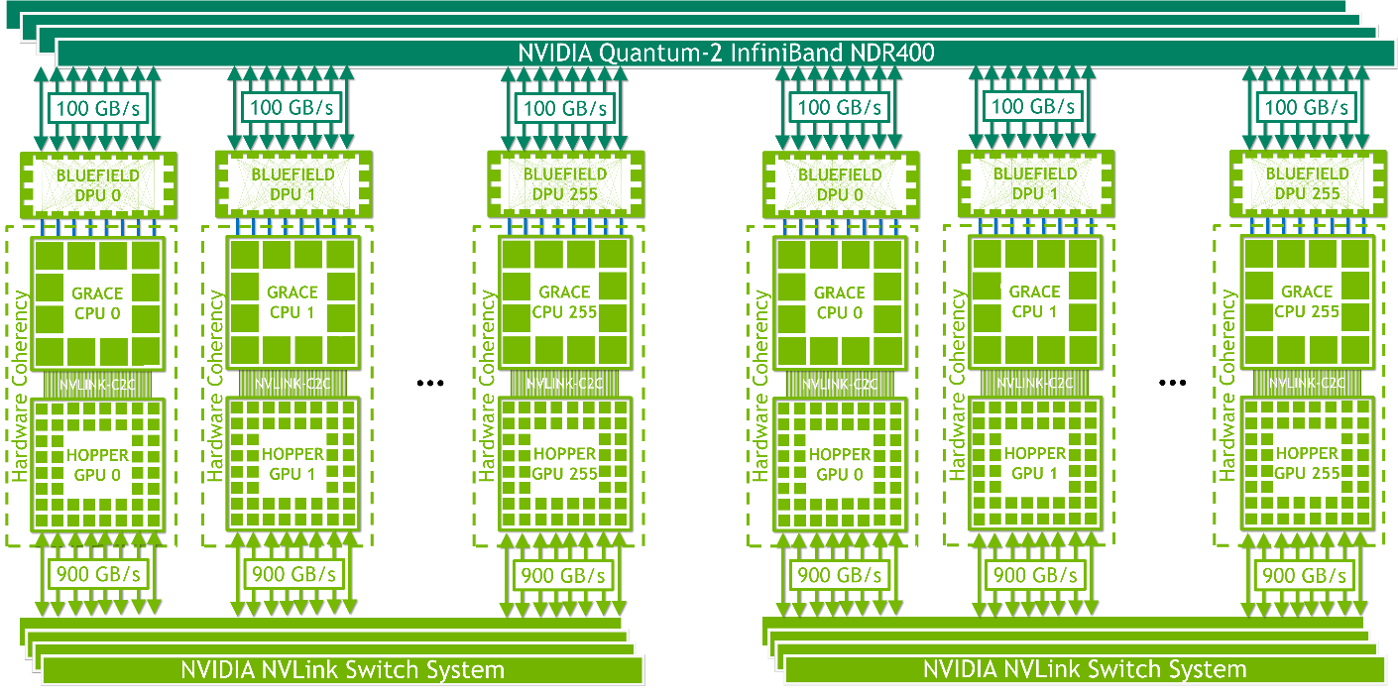
Supercomputer
The main difference between your phone and a supercomputer is that a supercomputer can do a lot of things at the same time (in parallel).
In artificial intelligence, we use graphics card (GPU) to process a lot of data in parallel.
Inside a GPU
A small square is called a core. Each core can run a program like the one we have written before. Because there are so many cores, the GPU can do a lot in parallel!
🔥A modern GPU has 16000 cores.
🔥🔥Modern supercomputers have thousands of GPUs.
Credits: images from https://www.msi.com/Graphics-Card/NX8800GTST2D320EHDOC/Specification and https://developer.nvidia.com/blog/nvidia-grace-hopper-superchip-architecture-in-depth/

Slide 9

Cloning Stitch!
So far, we had a single Stitch to execute the instructions.
​
Multiple cores? Multiple Stitch!​
​
Let's discover how to program multiple Stitch!
And why two Stitch are not always two times faster...
Credits: images from https://developer.nvidia.com/blog/nvidia-grace-hopper-superchip-architecture-in-depth/ and Wikipedia for Stitch.

Slide 10
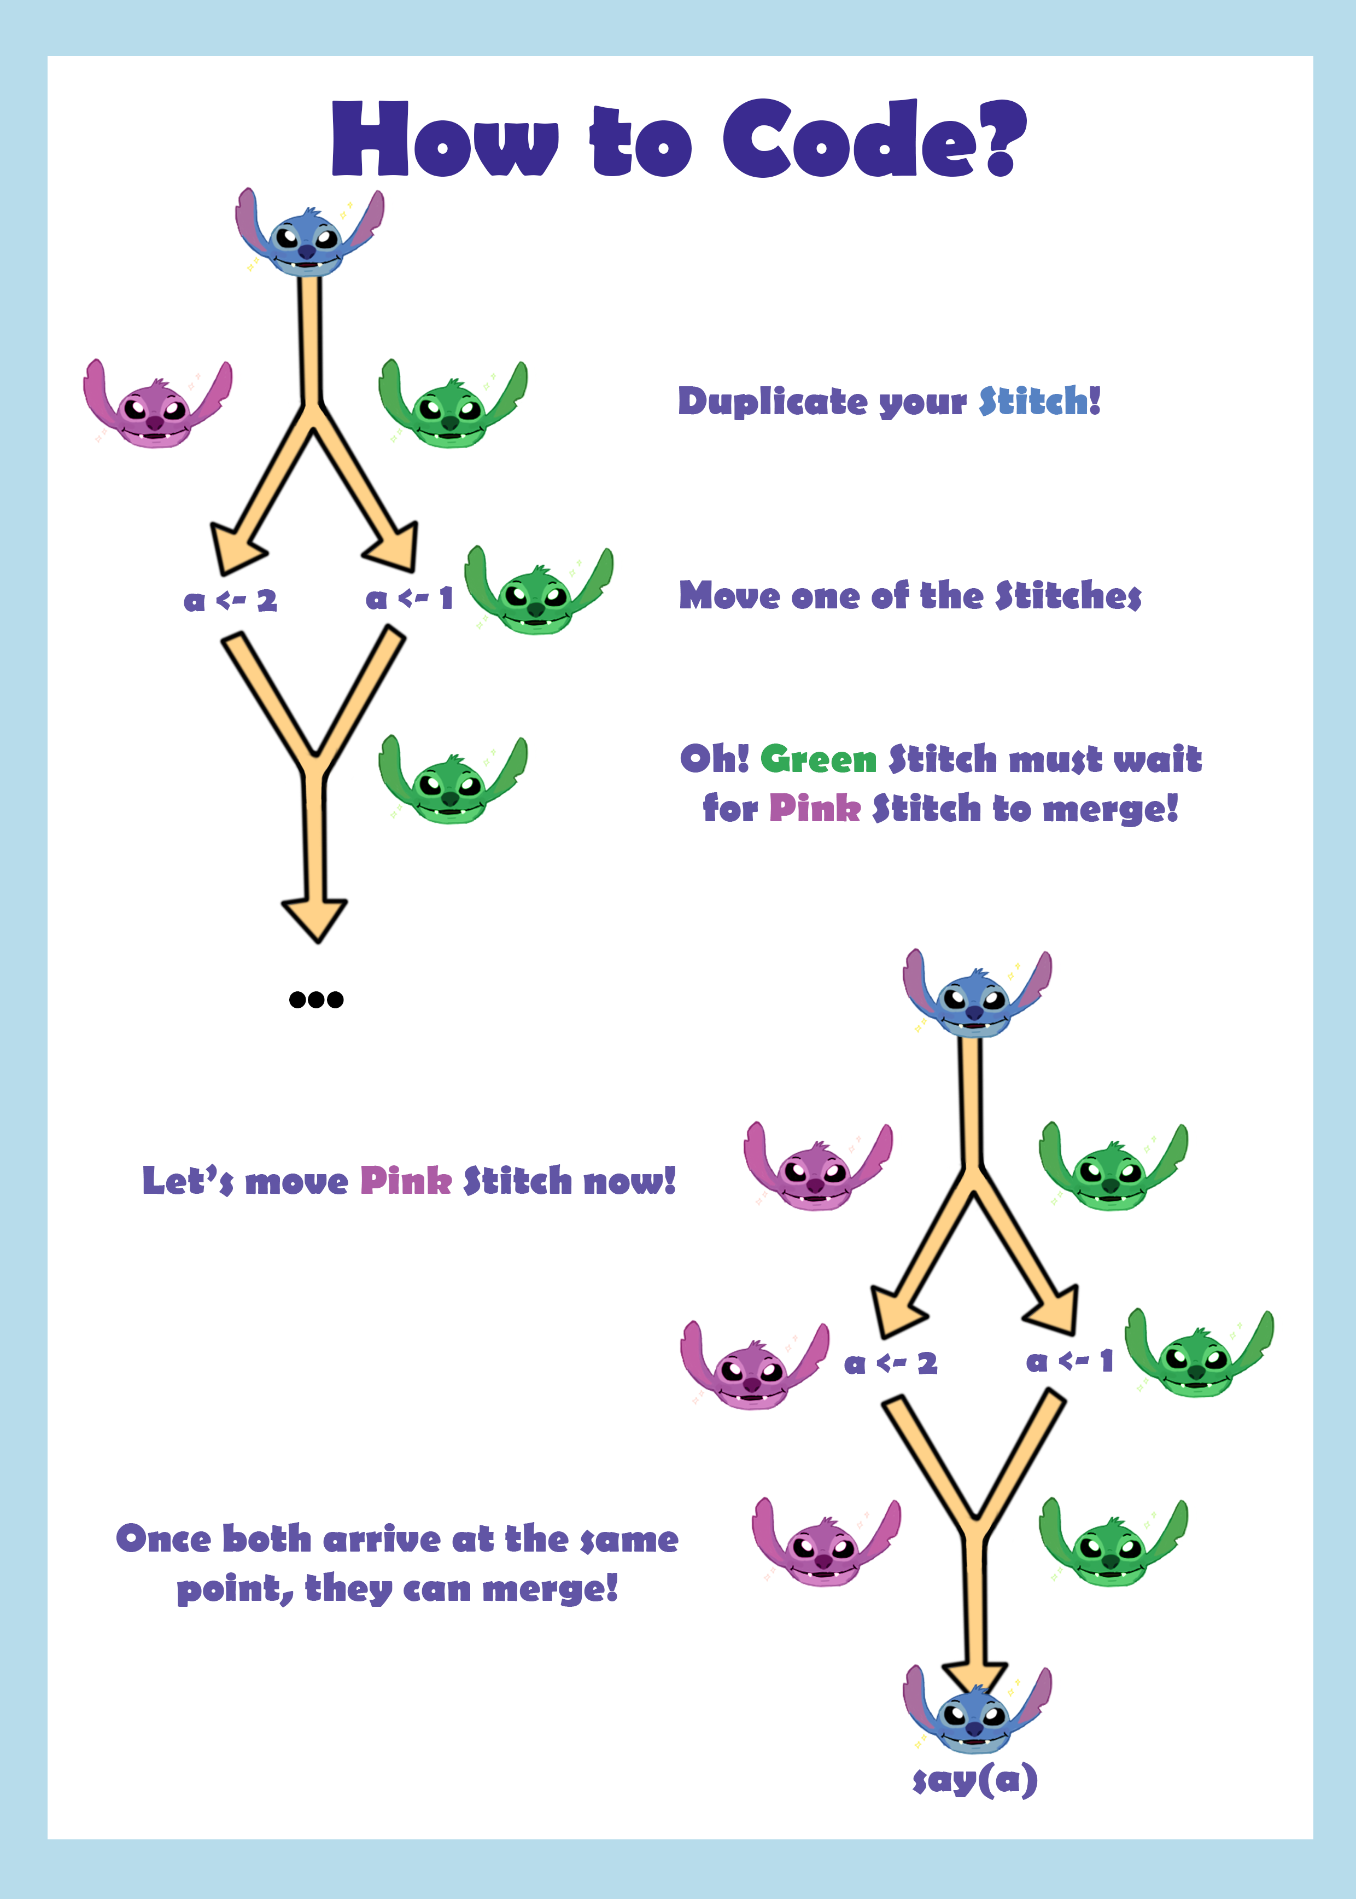

Slide 11
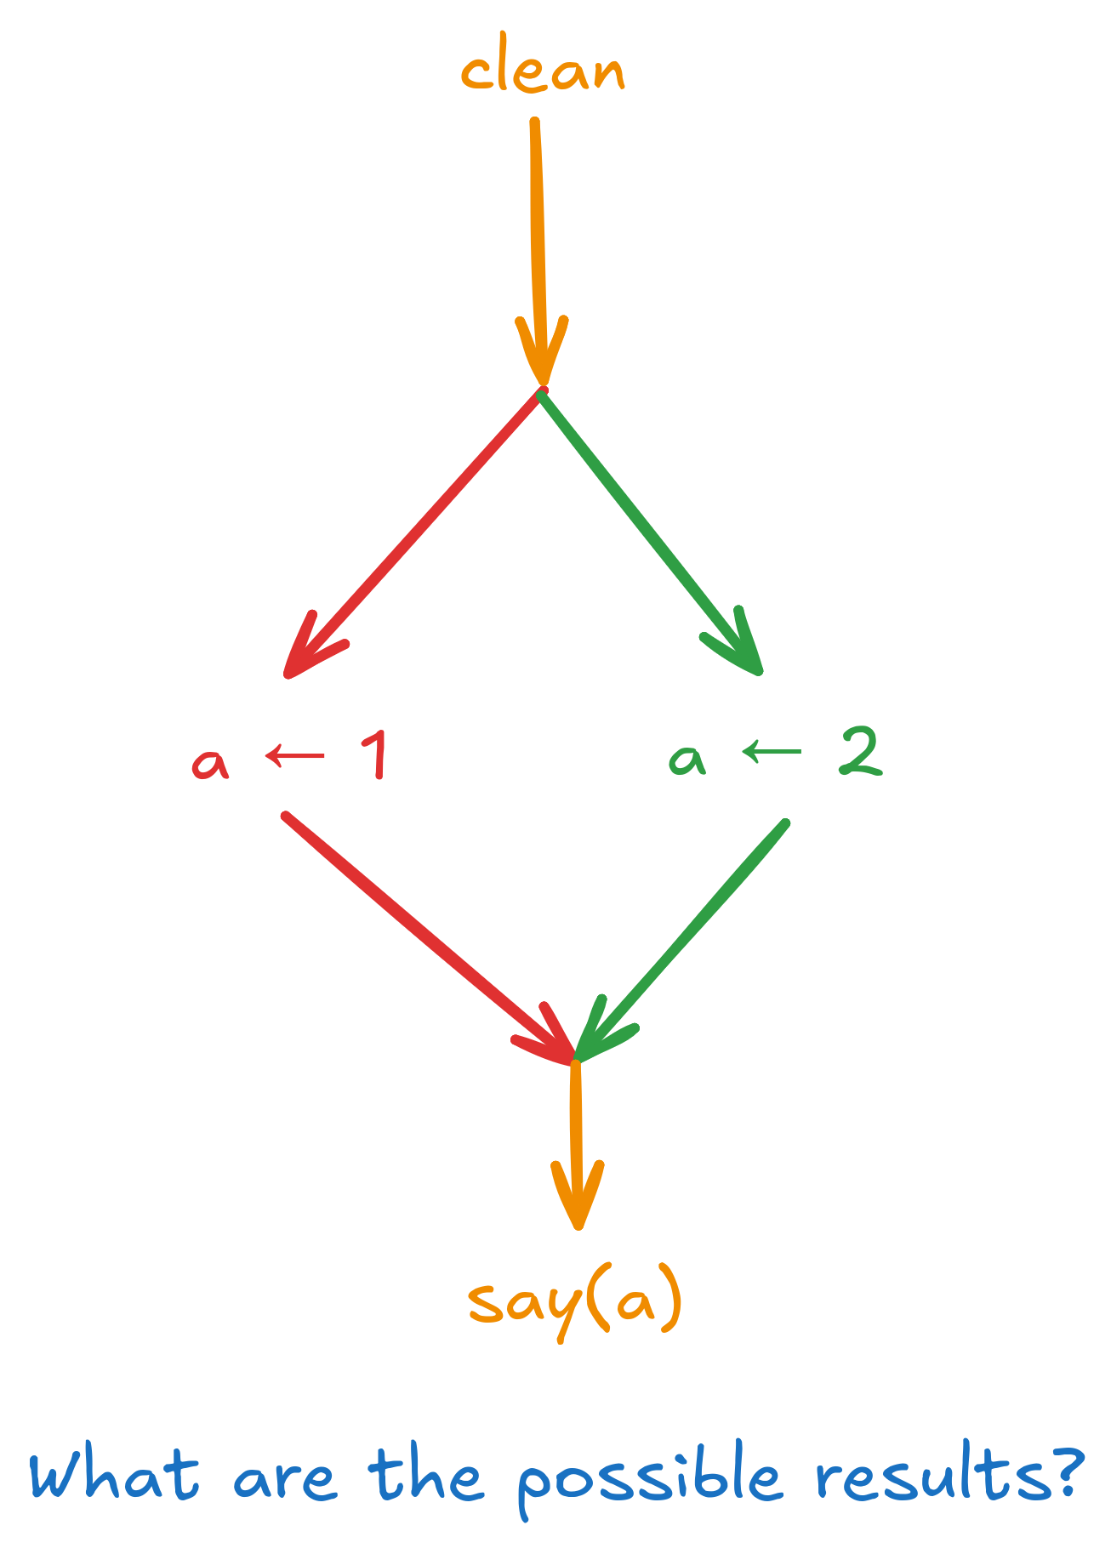

Slide 12
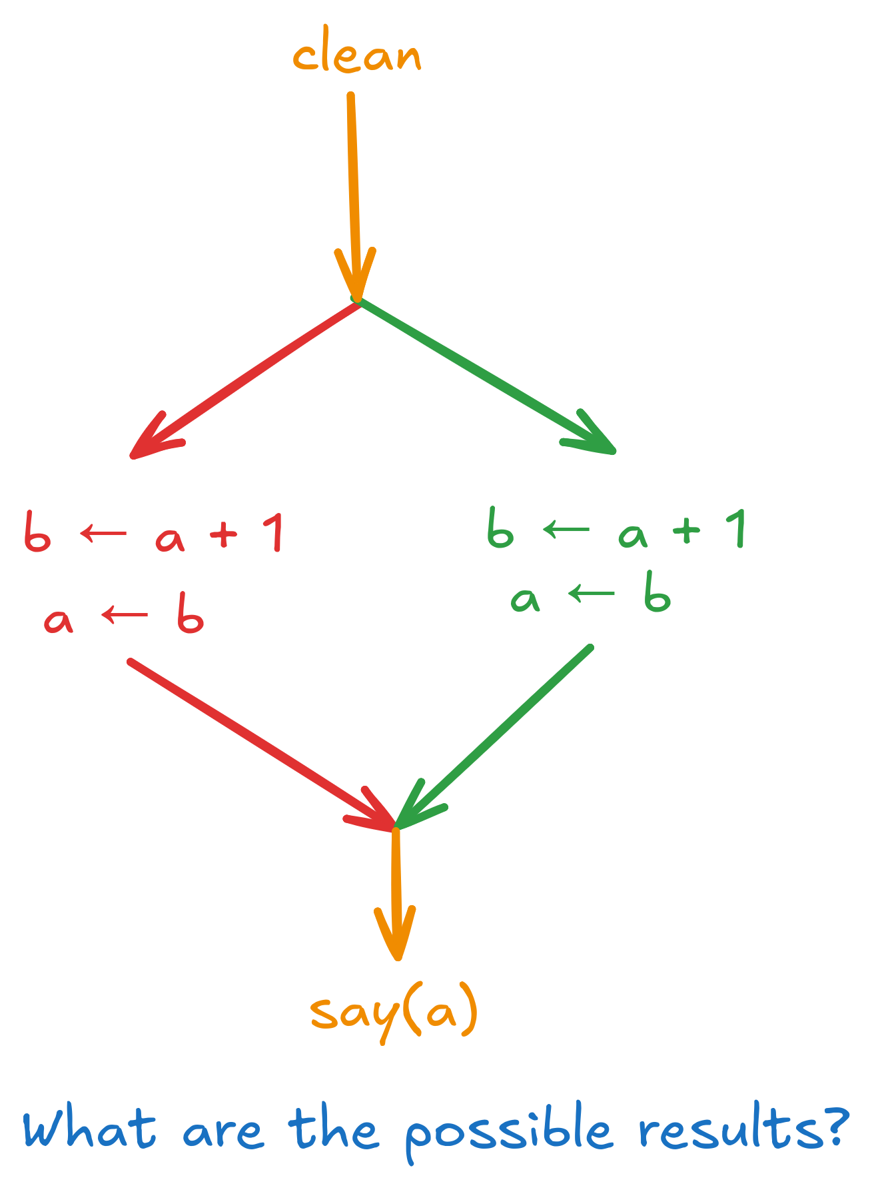

Slide 13
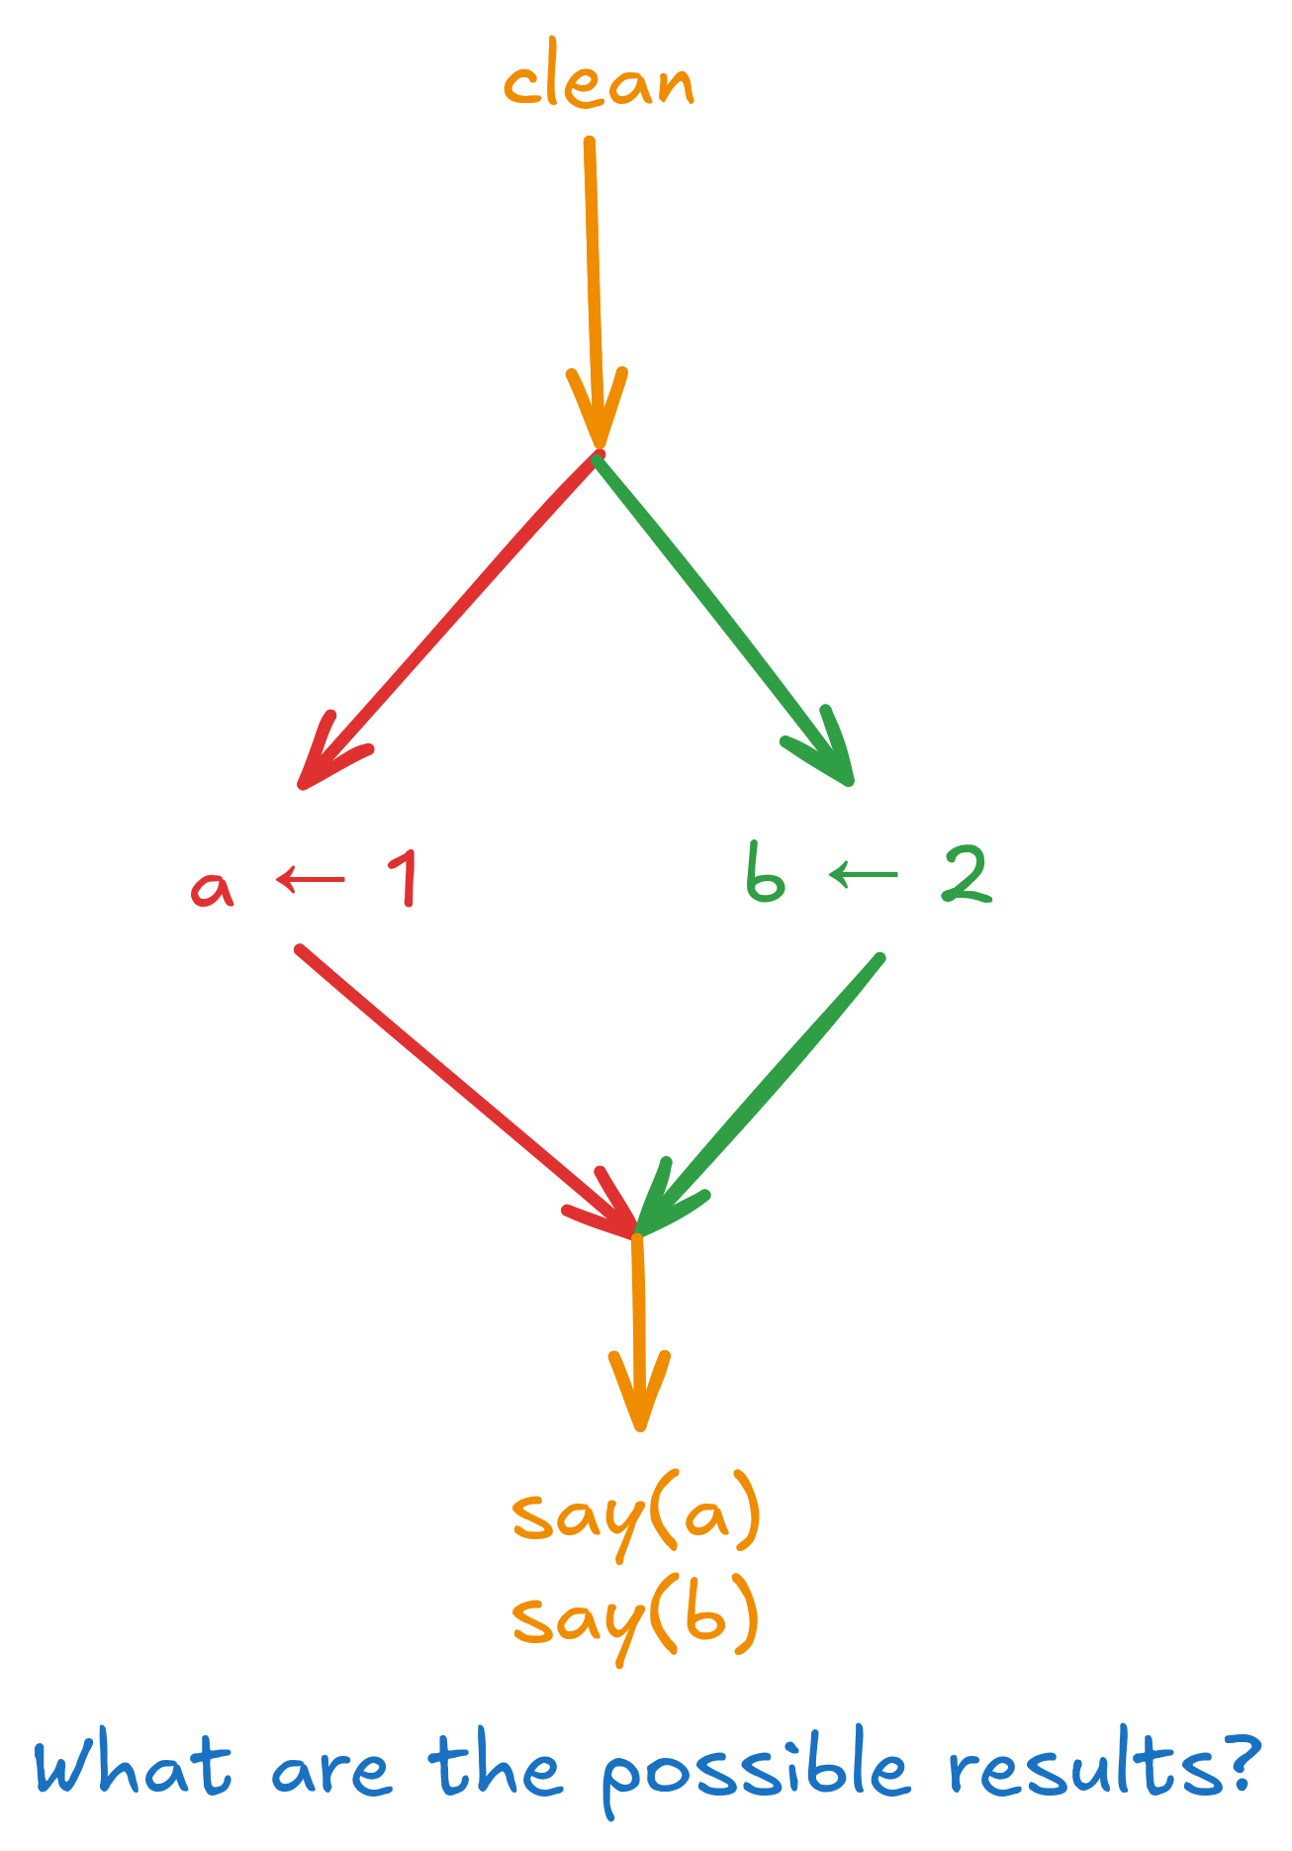

Slide 14
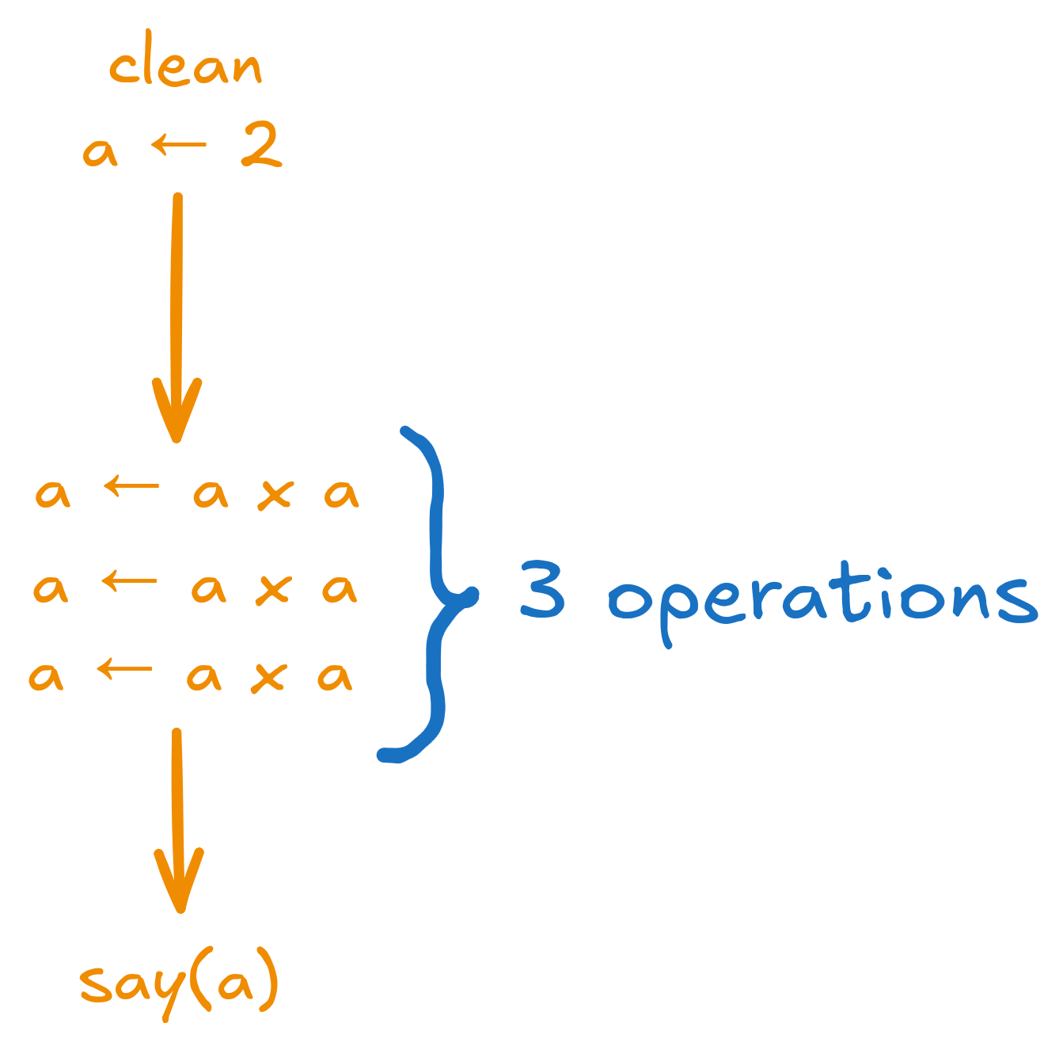
Compute 2 × 2 × 2 × 2
If each operation takes 1 second, it takes 3 seconds!
How long does it take with 2 Stitch?
What about three Stitch?

Slide 15
